Slide 1
Forecasting Analytics
Session 2

Slide 2

Forecast error
Forecast error is
If model is adequate, forecast error should contain no information
Plots of e_{t} should resemble that of ‘white noise’ or uncorrelated random numbers with 0 mean and constant variance
(There should be NO PATTERN).

Slide 3
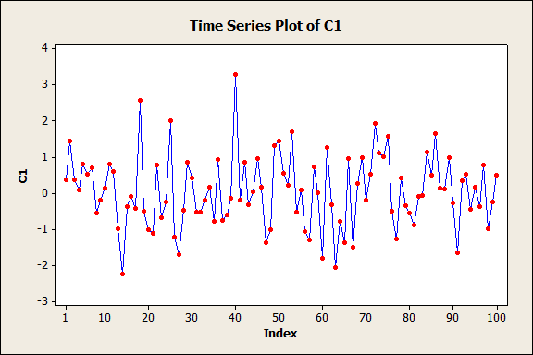
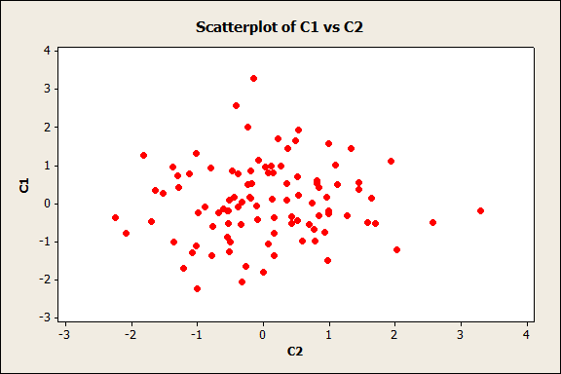
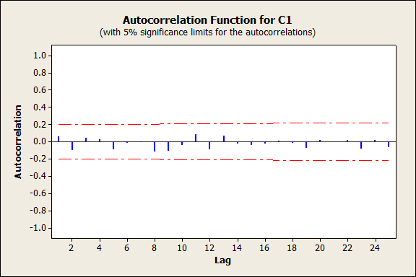
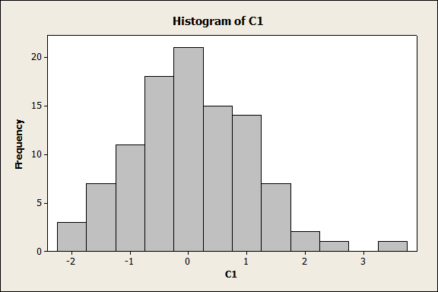
Typical plots of ‘white noise’
Time plot
Lag plot
ACF plot
Histogram

Slide 4
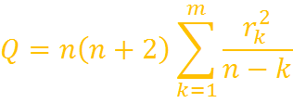
Formal test for checking randomness
Portmanteau test (Ljung-Box) on ACFs of the residuals:
Q has to be compared with cut-off of chi-square distribution with m degrees of freedom.
If it is smaller than the cut-off, the residuals can be said to be random.

Slide 5
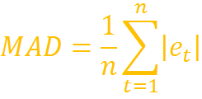
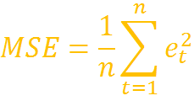
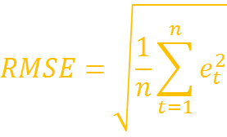
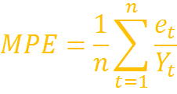
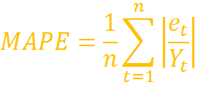
Summary measures of forecast error (for comparing models)
Mean absolute deviation
Mean squared error
Root mean squared error
Mean percentage error
Mean absolute percentage error

Slide 6

Example: Number of customers requiring repair work (Table 3-7)
Customers Y_t | Fitted value | Residual e_t | |e_t| | e_t^2 | e_t/Y_t | |e_t/Y_t|
58
54 | 58 | -4 | 4 | 16 | -0.07407 | 0.074074
60 | 54 | 6 | 6 | 36 | 0.1 | 0.1
55 | 60 | -5 | 5 | 25 | -0.09091 | 0.090909
62 | 55 | 7 | 7 | 49 | 0.112903 | 0.112903
62 | 62 | 0 | 0 | 0 | 0 | 0
65 | 62 | 3 | 3 | 9 | 0.046154 | 0.046154
63 | 65 | -2 | 2 | 4 | -0.03175 | 0.031746
70 | 63 | 7 | 7 | 49 | 0.1 | 0.1
 |  | MAD | MSE | RMSE | MPE | MAPE
 |  | 4.25 | 23.5 | 4.85 | 0.0203 | 0.0695
Forecast method: Last sample

Slide 7

Example: Number of customers requiring repair work (Table 3-7)
Customers Y_t | Fitted value | Residual e_t | |e_t| | e_t^2 | e_t/Y_t | |e_t/Y_t|
58
54
60
55 | 57.3333 | -2.3333 | 2.3333 | 5.4444 | -0.0424 | 0.0424
62 | 56.3333 | 5.6667 | 5.6667 | 32.1111 | 0.0914 | 0.0914
62 | 59.0000 | 3.0000 | 3.0000 | 9.0000 | 0.0484 | 0.0484
65 | 59.6667 | 5.3333 | 5.3333 | 28.4444 | 0.0821 | 0.0821
63 | 63.0000 | 0.0000 | 0.0000 | 0.0000 | 0.0000 | 0.0000
70 | 63.3333 | 6.6667 | 6.6667 | 44.4444 | 0.0952 | 0.0952
 |  | MAD | MSE | RMSE | MPE | MAPE
 |  | 3.83 | 19.91 | 4.46 | 0.0458 | 0.0599
Forecast method: 3-point moving average

Slide 8



Aside: Preview of forecast methods based on smoothing
There are two major forecasting techniques based on smoothing
Moving averages
Exponential smoothing

Slide 9
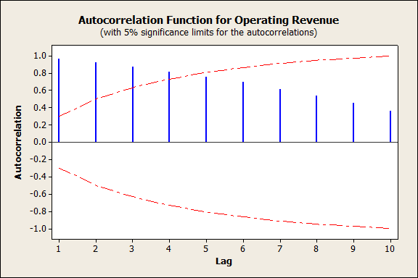
Example: Forecasting 2005 sales of Sears from 1955-2004 data (Table 3-4)

Slide 10
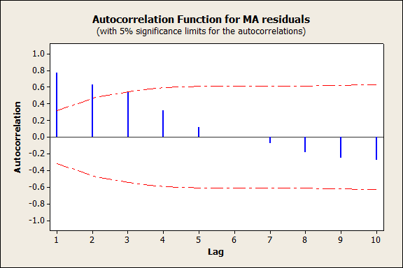
Sears sales data: ACF of 5-point MA residuals

Slide 11
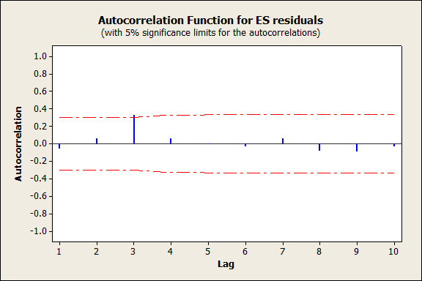
Sears sales data: ACF of Exponential smoothing residuals

Slide 12
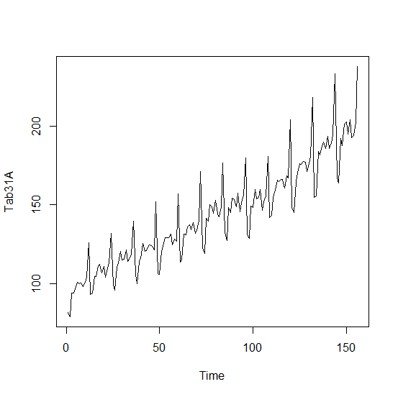
Example: Monthly sales for All US retail stores,1983-1995 (Table 3.8)

Slide 13
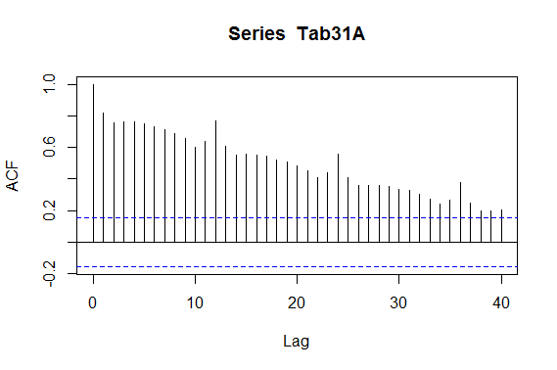
Autocorrelation function for retail sales

Slide 14
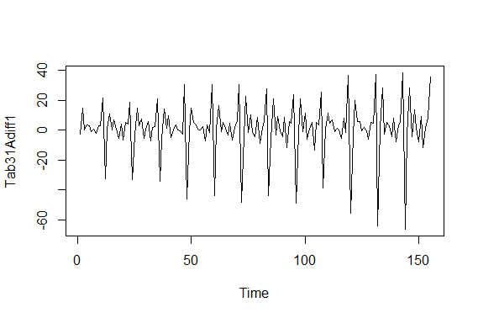
Time plot of US Monthly retail sales: differenced

Slide 15
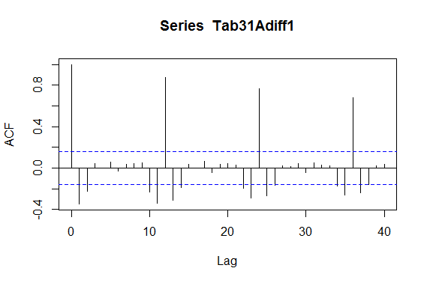
ACF of US Monthly retail sales: differenced

